Slide 1

M.Sc. AIML & Data Science Semester – VIII CC-416: PROJECT-III: Project
Group | 18
Roll No. | 21
Name | Yatrik Shah
Title | Drive Insights
Under the Guidance of Rashmi Pandey, Ravi Gor.
Department of AIML & Data Science School of Emerging Science & Technology Gujarat University

Slide 2

Outline
Problem Statement
Abstract and Information
Methodology and Features
Real Life Applications
Glimpse of Frontend and Application usage

Slide 3
Problem Statement
The traditional approach to visitor management at residential and corporate buildings involves manual processes such as filling out paper forms and recording visitor details in logbooks.
These processes can be time-consuming, error-prone, and inefficient, leading to security and safety risks.
Therefore, there is a need for a more efficient, automated, and data-driven approach to visitor management that can enhance security, streamline processes, and generate valuable insights.

Slide 4
Abstract and Introduction
Drive Insights is an end-to-end machine learning web application that streamlines visitor management and enhances security at residential and corporate buildings.
The app uses computer vision and natural language processing techniques to detect vehicles, read license plates, and identify drivers.
The app also collects relevant information such as driver's name, phone number, destination, and purpose of visit, and saves the current time.

Slide 5
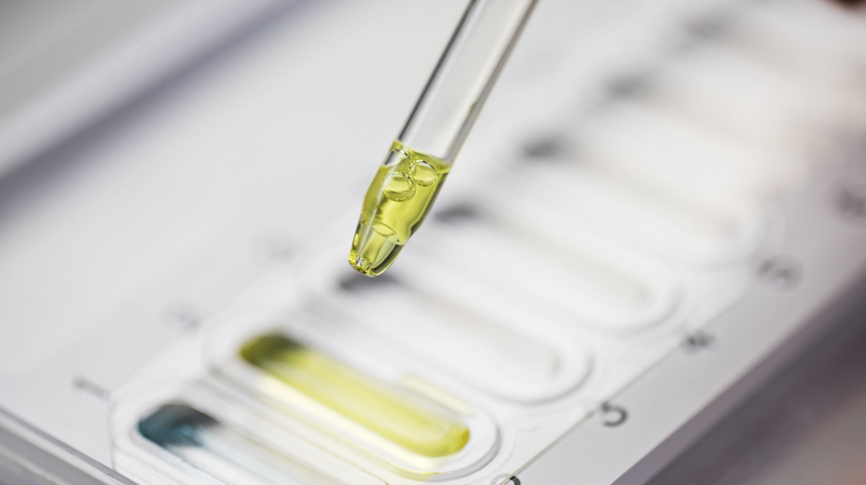
Methodology
•Data collection •Time stamping
•Data preprocessing •Integration
•Vehicle detection •Testing and validation
•Vehicle classification •Deployment
•Number Plate Detection
•Number Plate Recognition
•Driver details collection
•Data storage

Slide 6

Number Plate Detection and Recognition
Drive Insights uses computer vision techniques to detect and recognize license plates on vehicles.
Using this app we can capture vehicle image in real time and a trained machine learning model to detect the number plate.
It then uses OCR (Optical Character Recognition) to convert the image into text that can be read and understood by the app.

Slide 7

Vehicle Recognition
The Drive Insights app is equipped with advanced computer vision techniques that allow it to detect and classify vehicles passing in real time.
This can classify the vehicles in three major classes:
Car
Bike
Auto Rickshaw

Slide 8
Rider / Driver Details
This feature allows the app to collect relevant information such as the rider's/driver's name, phone number, destination, and purpose of visit.
This feature can help building management keep track of who is entering the building and for what purpose. It can also assist in creating a seamless visitor management system.

Slide 9
Multi-user System
This application is built based on multiple user concept.
Such that more than one user can use the application with their respective “userID” and “Password”.
Separate Database for each user so that no user can access any other user’s database

Slide 10

Database
SQLite
Time & Date
Number Plate , Vehicle Type , Rider / Driver Details
Download Database
Reset Session

Slide 11
Frontend - API
This is one of the most important step of the project.
Here, first of all, evert functionality of the project is tested seperately.
Here Multiple responsive templated are made using HTML, CSS and JavaScript accordingly to the problem statement and user-friendliness.
Here Flask framework is used as the RestAPI to build the web application.

Slide 12
Real Life Applications
Visitor Management at Residential Buildings
Visitor Management at commercial Buildings
Used at any Events or functions for security enhancement
Parking management
Toll Collection

Slide 13
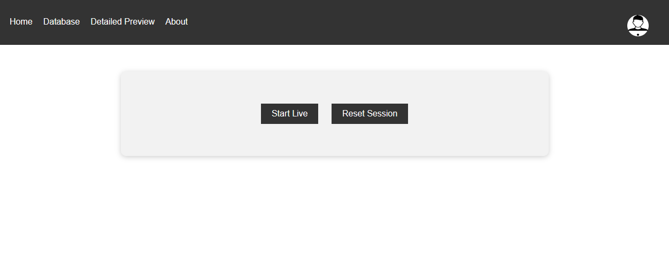
Glimpse of Frontend

Slide 14
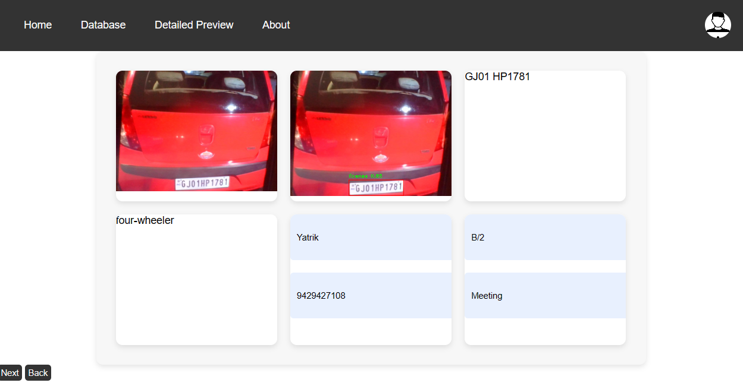

Slide 15

Any Questions ?

Slide 16

Thank You

